Slide 1

Depression Detection from Social Media Comments Using Deep Learning (Task 3)
Group No: 14
Group Members:
Syed Md. Ahnaf Hasan (ID: 23266008)
Md. Tanvir Hossain (ID: 24166030)

Slide 2
Outline
Dataset Overview + EDA
Preprocessing (Tokenization)
Methodology
Architecture of RNN models
Hyperparameters
GloVe
Bert Base Uncased
LIME
Performance metrics
Links to reference codes

Slide 3
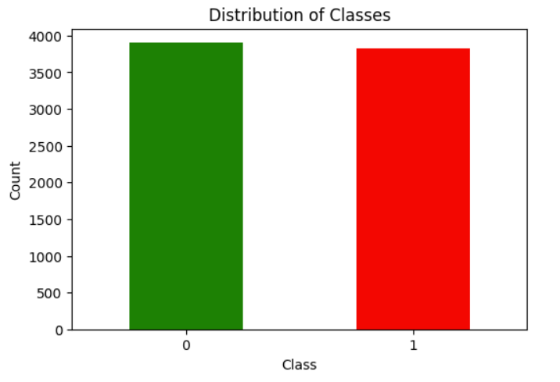
Dataset overview + EDA
We will use the “Depression: Reddit Dataset (Cleaned)” used in the paper titled “Exploring the Impact of Word Embedding Dimensions on Depression Data Classification Using BiLSTM Model”. Link: https://www.kaggle.com/datasets/infamouscoder/depression-reddit-cleaned/code
The dataset contains 7731 labeled user comments with label ‘1’ indicating depression and ‘0’ indicating no depression.

Slide 4
Dataset overview + EDA
The dataset contains 2 columns: “clean_text” and “is_depression” which contain the texts and labels of the text respectively.
The text in the dataset was a cleaned as it had no punctual marks, symbols, etc. And the text was in lower case as well.
There are 3900 non depressive instances (label 0) and 3831 depressive instances (label 1). Two instances of the 2 available classes from the dataset are shown below:
clean_text | is_depression
i dont even deserve to live | 1
sooo sick of the snow ughh | 0

Slide 5
Preprocessing (Tokenization)
To feed the data to the deep learning models they need to be converted to numerical forms. For this purpose we use tokenization.
Tokenization assigns an integer value to each word or token in a text.
For the RNN models, we use the tokenizer class from keras library to create a tokenizer. Then we fit the tokenizer with the training split from the dataset. Then we apply zero padding and truncation to make all the sequences of the same length.
For Bert Base uncased model, the Bert Tokenizer from hugging face library is used. This tokenizer handles the tokenization as well as padding and truncation.

Slide 6
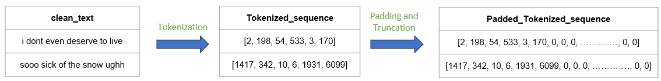
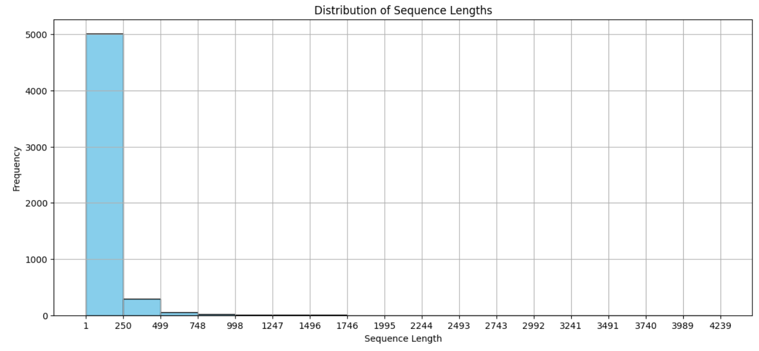
Preprocessing (Tokenization)
The max sequence length among all the instances is found to be 4239.
Majority lie within 250 sequence length. Therefore, chosen max length for all sequences is 250. Smaller sequences will be padded and longer will be truncated.

Slide 7
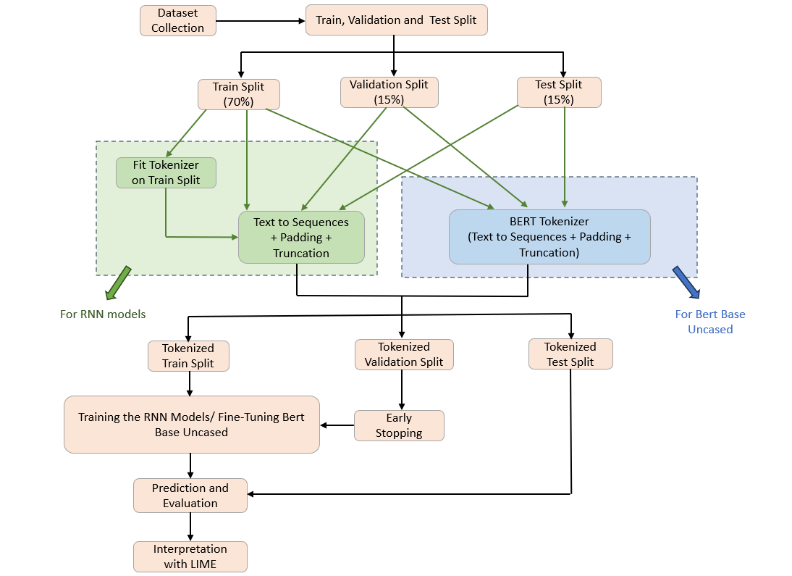
Methodology

Slide 8
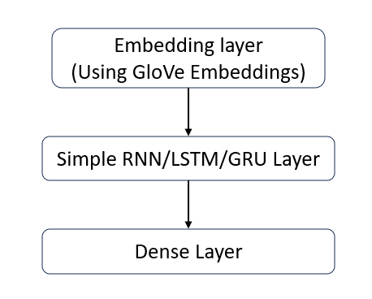
Architecture of RNN models
The first layer used in the RNN models is the embedding layer. This Layer uses the GloVe pre-trained embeddings to convert the tokens in the text sequences to word vectors to provide more context. The dimension of embeddings is 100.
The second layer contains either Simple RNN/LSTM/GRU layer of 32 units. Both unidirectional and Bidirectional variations of the mentioned layers are used in individual models.
The final layer contains a dense unit with a sigmoid activation function which will be used for generating probabilities for the labels for classification.

Slide 9
Hyperparameters
Parameter Name | Value
Simple RNN/LSTM/GRU units | 32
Vocabulary Size of Tokenizer (For RNN models) | 10000
Max length of sequences (After padding and truncation) | 256
Word Embedding Dimension | 100
Early Stopping Patience | 3
Number of epochs | 50

Slide 10
GloVe
GloVe: Global Vectors for Word Representation is a technique to generate word embeddings. Word embeddings incorporate the different aspects of a word’s meaning.
The GloVe 6B 100d pretrained word embeddings were used. There are 4,00,000 word embeddings available in this embeddings set.
The GloVe embeddings are used in the embedding layer of the RNN models.

Slide 11
BERT Base Uncased
BERT: Bidirectional Encoder Representations from Transformers is a encoder based transformer model which is pretrained on a large corpus.
BERT base uncased which is a variant of BERT from Hugging face Transformers library is used in this project.
BERT base uncased has got 110 million parameters

Slide 12
LIME
LIME: Local Interpretable Model-agnostic Explanations is an explainable (XAI) model, used to interpret local predictions made by a black box model.
It explains a model’s prediction for a data instance based on the importance given to each of its features.
It can help to improve the faith in a black box deep learning model’s predictions.
LIME is used in this project to explain local predictions made by the trained models.

Slide 13
Performance Metrics
Accuracy
Precision
Recall
F1 Score

Slide 14
Links to the reference codes
The codes used in the following links were referred for out project:
https://nzlul.medium.com/the-classification-of-text-messages-using-lstm-bi-lstm-and-gru-f79b207f90ad
https://www.sabrepc.com/blog/Deep-Learning-and-AI/text-classification-with-bert
https://coderzcolumn.com/tutorials/machine-learning/how-to-use-lime-to-understand-sklearn-models-predictions#lime_image

